Slide 1
Objective of the class
Introduction to Numpy
What is numpy?
numpy performance test
Introduction to numpy arrays
Introduction to numpy function
Dealing with Flat files using numpy
Mathematical functions
Statisticals function
Operations with arrays

Slide 2
NumPy
NumPy is an extension to the Python programming language, adding support for large, multi-dimensional arrays and matrices, along with a large library of high-level mathematical functions to operate on these arrays
To install NumPy run:
python setup.py install
To perform an in-place build that can be run from the source folder run:
python setup.py build_ext --inplace
The NumPy build system uses distutils and numpy.distutils. setuptools is only used when building via pip or with python setupegg.py.

Slide 3
NumPy
Official Website: http://www.numpy.org
NumPy is licensed under the BSD license, enabling reuse with few restrictions.
NumPy replaces Numeric and Numarray
Numpy was initially developed by Travis Oliphant
There are 225+ Contributors to the project (github.com)
NumPy 1.0 released October, 2006
Numpy 1.14.0 is the lastest version of numpy
There are more than 200K downloads/month from PyPI

Slide 4
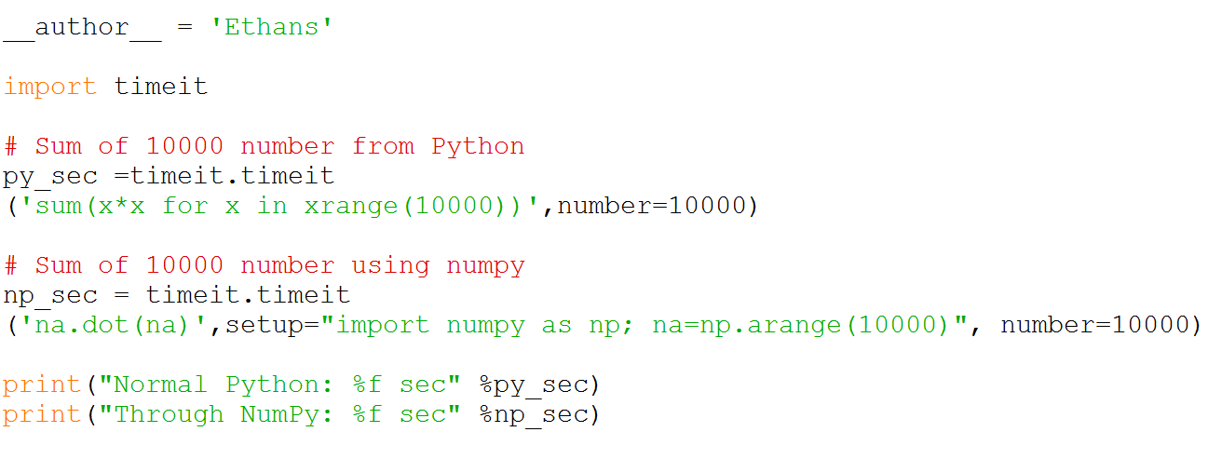
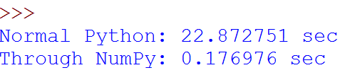
NumPy performance Test

Slide 5
Getting Started with Numpy
>>> # Importing Numpy module
>>> import numpy
>>> import numpy as np
IPython has a ‘pylab’ mode where it imports all of NumPy, Matplotlib,
and SciPy into the namespace for you as a convenience. It also enables
threading for showing plots

Slide 6
Getting Started with Numpy
Arrays are the central feature of NumPy.
Arrays in Python are similar to lists in Python, the only difference being the array elements should be of the same type
import numpy as np
a = np.array([1,2,3], float) # Accept two arguments list and type
print a # Return array([ 1., 2., 3.])
print type(a) # Return <type 'numpy.ndarray'>
print a[2] # 3.0
print a.dtype # Print the element type
print a.itemsize # print bytes per element
print a.shape # print the shape of an array
print a.size # print the size of an array

Slide 7
Getting Started with Numpy
a.nbytes # return the total bytes used by an array
a.ndim # provide the dimension of an array
a[0] = 10.5 # Modify array first index important decimal will come if the array is float type else it will be hold only 10
a.fill(20) # Fill all the values by 20
a[1:3] # Slice the array
a[-2:] # Last two elements of an array

Slide 8
Airthmatic Operation with numpy

Slide 9
Multi-Dimensional Arrays
import numpy as np
a = np.array([[1,2,3], [4,5,6]], int) # Accept two arguments list and type
>>> a.shape # Return (2, 3)
>>> a.ndim # return 2
>>> a[0][0] # Return 1
>>> a[0,0] # Return 1
>>> a[1,2] # Return 6
>>> a[1:] # Return array([[4, 5, 6]])
>>> a[1,:] # Return array([4, 5, 6])
>>> a[:2] # Return array([[1, 2, 3],[4, 5, 6]])
>>> a[:,2] # Return array([3, 6])
>>> a[:,1] # Return array([2, 5])
>>> a[:,0] # Return array([1, 4])

Slide 10
Reshaping array
import numpy as np
a = np.array([[1,2,3], [4,5,6]], int) # Accept two arguments list and type
>>> b = a.reshape(3,2) # Return the new shape of array
>>> b.shape # Return (3,2)
>>> len(a) # Return length of a
>>> 2 in a # Check if 2 is available in a
>>> b.tolist() # Return [[1, 2], [3, 4], [5, 6]]
>>> list(b) # Return [array([1, 2]), array([3, 4]), array([5, 6])]
>>> c = b
>>> b[0][0] = 10
>>> c # Return array([[10, 2], [ 3, 4], [ 5, 6]])

Slide 11
Slices Are References
>>> a = array((0,1,2,3,4))
# create a slice containing only the
# last element of a
>>> b = a[2:4]
>>> b
array([2, 3])
>>> b[0] = 10
# changing b changed a!
>>> a
array([ 0, 1, 10, 3, 4])

Slide 12
arange function and slicing
>>> a = np.arange(1,80, 2)
array([ 1, 3, 5, 7, 9, 11, 13, 15, 17, 19, 21, 23, 25, 27, 29, 31, 33,
35, 37, 39, 41, 43, 45, 47, 49, 51, 53, 55, 57, 59, 61, 63, 65, 67,
69, 71, 73, 75, 77, 79])
>>> a[[1,5,10]] # Return values at index 1,5 and 10
>>> myIndexes = [4,5,6]
>>> a[myIndexes] # Return values at indexes 4,5,6..
>>> mask = a % 5 == 0 # Return boolean value at those indexes
>>> a[mask]
Out[46]: array([ 5, 15, 25, 35, 45, 55, 65, 75])

Slide 13
Where function
>>> where (a % 5 == 0)
# Returns - (array([ 2, 7, 12, 17, 22, 27, 32, 37], dtype=int64),)
>>> loc = where(a % 5 == 0)
>>> print a[loc]
[ 5 15 25 35 45 55 65 75]

Slide 14
Flatten Arrays
# Create a 2D array
>>> a = array([[0,1],
[2,3]])
# Flatten out elements to 1D
>>> b = a.flatten()
>>> b
array([0,1,2,3])
# Changing b does not change a
>>> b[0] = 10
>>> b
array([10,1,2,3])
>>> a
array([[0, 1],
[2, 3]])

Slide 15
Transpose Arrays
>>> a = array([[0,1,2],
... [3,4,5]])
>>> a.shape
(2,3)
# Transpose swaps the order # of axes. For 2-D this # swaps rows and columns.
>>> a.transpose()
array([[0, 3], [1, 4],[2, 5]])
# The .T attribute is # equivalent to transpose().
>>> a.T
array([[0, 3],
[1, 4],
[2, 5]])

Slide 16
Arrays from/to ASCII files
csv = np.loadtxt(r'A:\UPDATE Python\Module 11\Programs\constituents-financials.csv', skiprows=1, dtype=str, delimiter=",", usecols = (3,4,5))

Slide 17
Other format supported by other similar package

